Slide 1
BRC Lab meeting
10/10/2019
Matteo Ferla

Slide 2
Web apps
Michelaɴɢʟo
Create and edit pages with user-submitted annotations
Gene name, PDB file or PDB
Can create a visual only of a variant with a given mutation
VENUS
Gene name and mutation
Determine automatically the effect of a mutation based on a series of factors
Create a Michelaɴɢʟo page

Slide 3
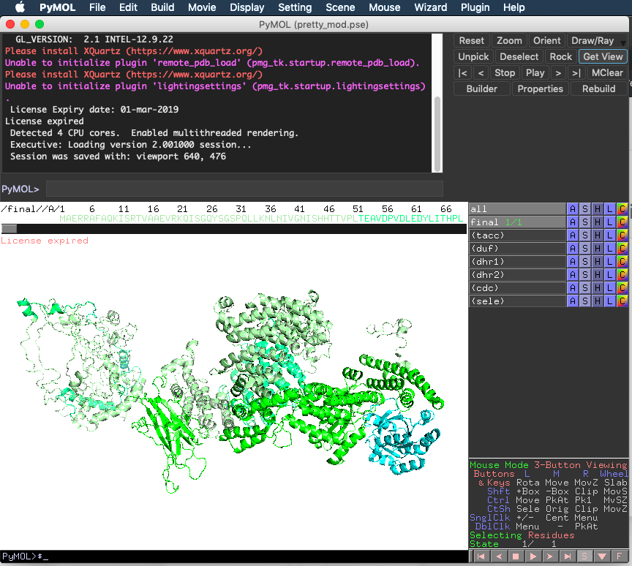
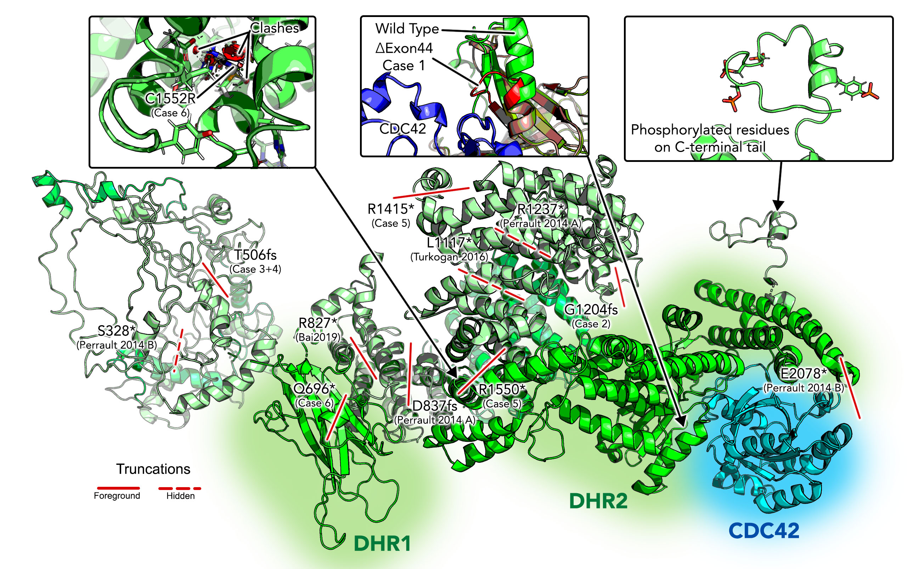
Biochemists may make pretty figures

Slide 4

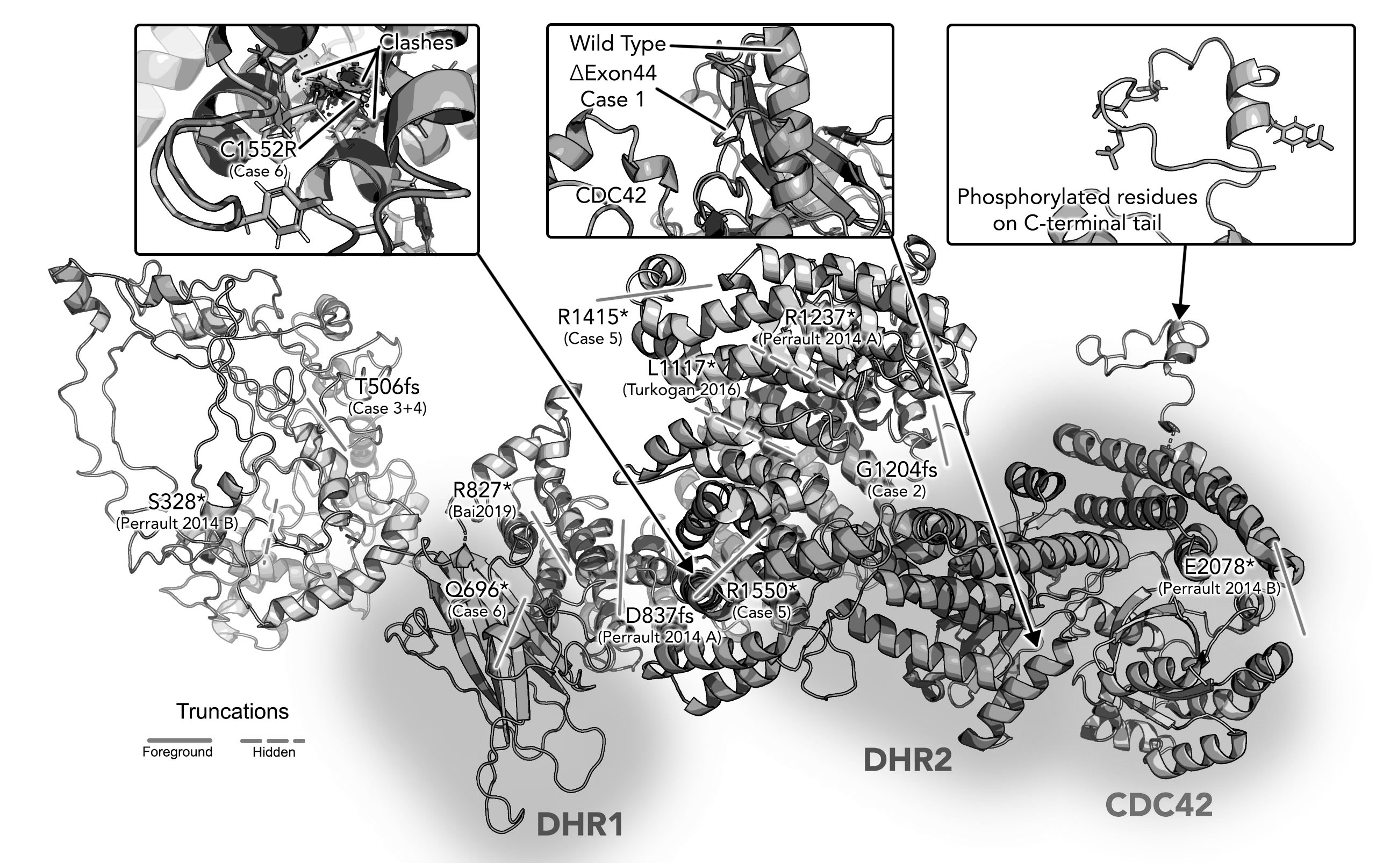
3D → 2D: Hard to follow
“Where is my residue in this figure??”
“Is that it, behind this loop?”

Slide 5
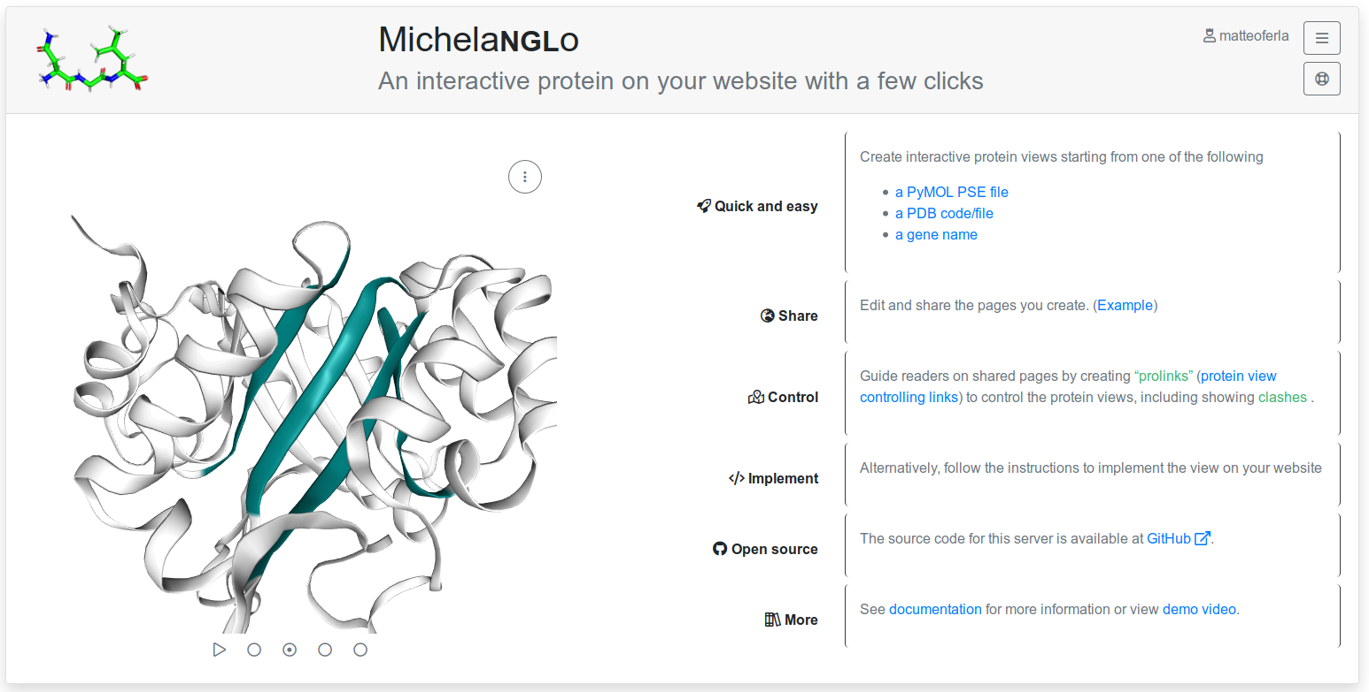
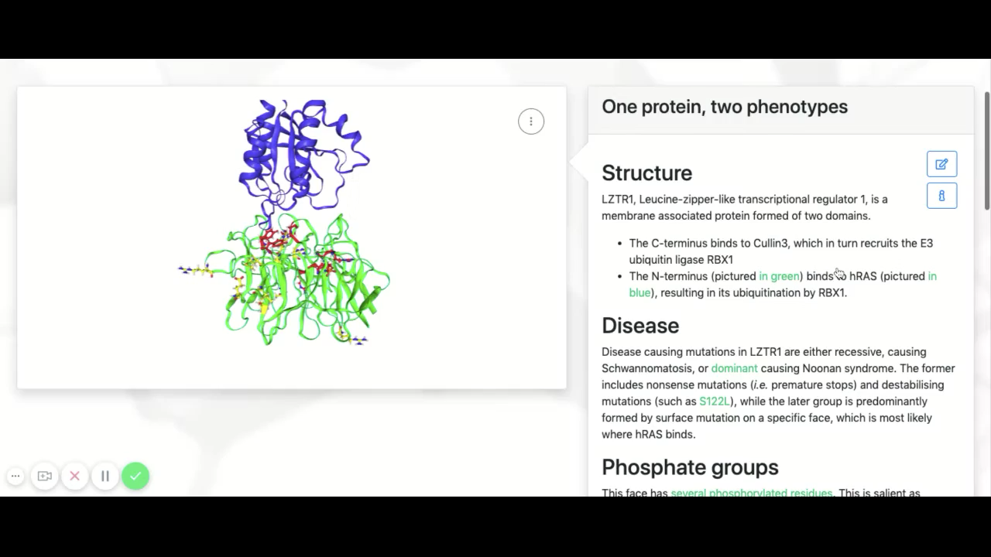
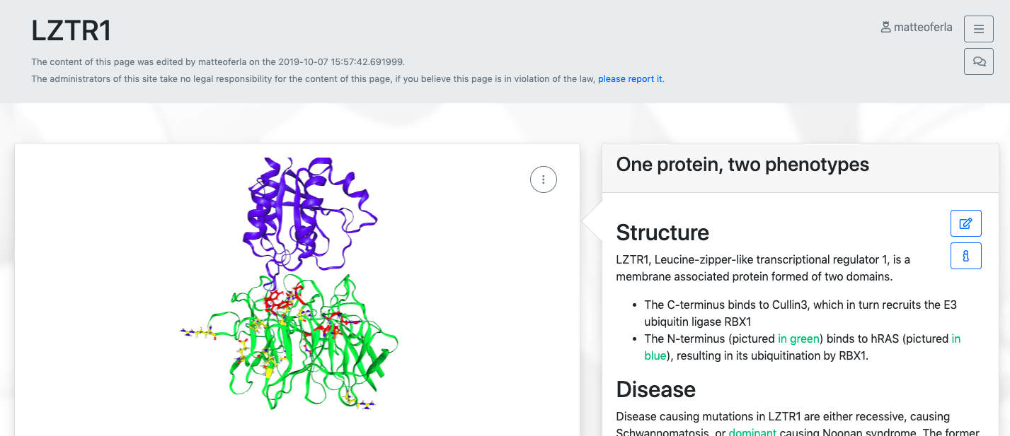
Michelaɴɢʟo
A site to create pages with interactive protein structure that can be controlled by links in the user written description
Start from gene name, PDB code, PDB file or PyMOL file
Front page: https://michelanglo.sgc.ox.ac.uk
Navigation in a user created page

Slide 6
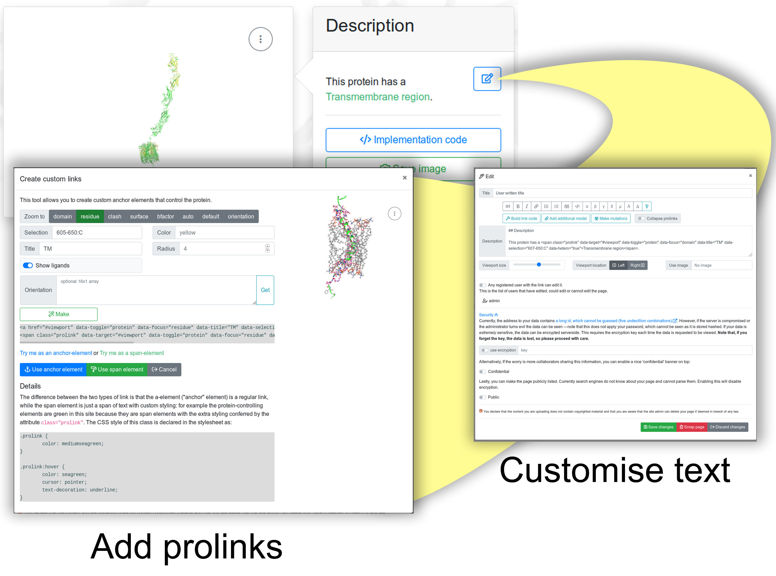
Protein controlling links
The page author creates the protein controlling links (prolinks) via the interface
The reader clicks the link and the protein is changed
This allows clearer explanations, even to non-biochemist readership

Slide 7
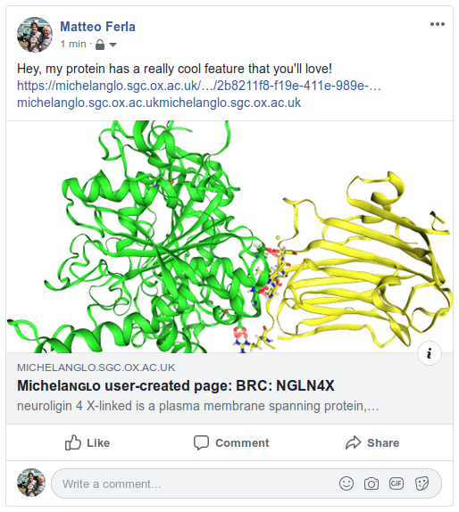
Features
Instructions on how to implement a view on one’s own site
Multiple models
Mutagenesis
Option to start from an image (e.g. paper figure) that toggles into an iteractive viewer
Page monitoring to guarantee the views do not change
Thumbnails for when you share protein pages with your friends on social media

Slide 8
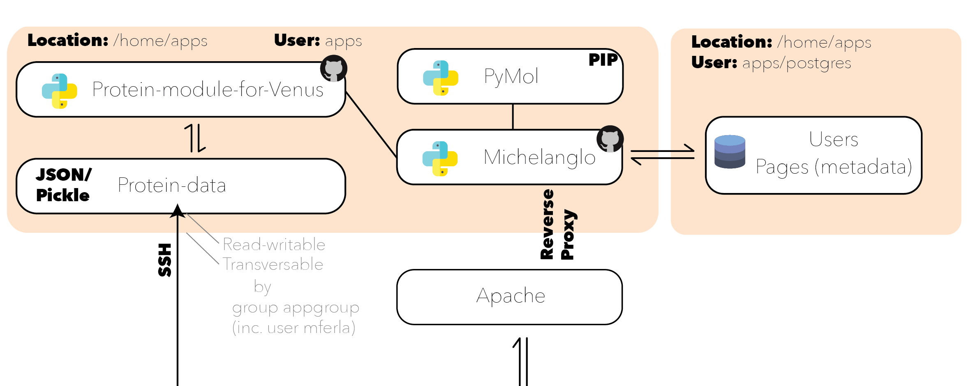
Layout

Slide 9
Technologies
Backend
Python 3
Pyramid
Waitress (Apache: reverse proxy)
PyMOL
Biopython
APScheduler
Postgres
NodeJS
Puppeeter
Frontend
NGL
JQuery
Boostrap4
FontAwesome Pro

Slide 10
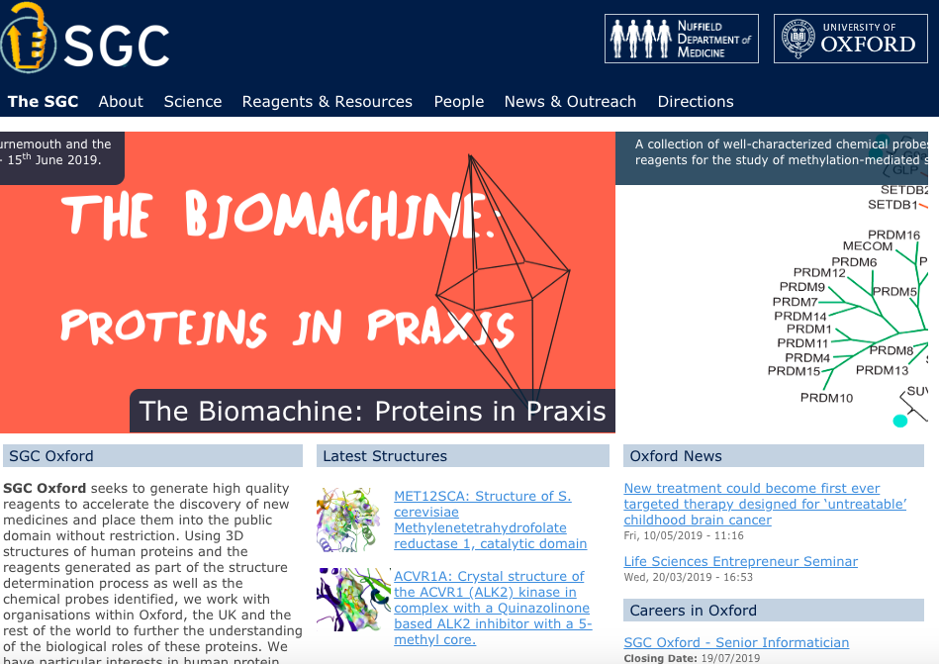
JavaScript libraries for structures
There are several JS libaries
NGL
PV
Jmol.js (Java Applet)
Etc.
Implemented on large databases, but not academic sites

Slide 11
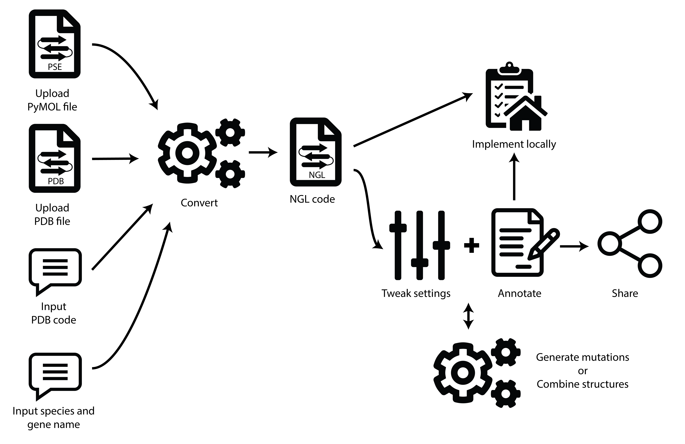
User’s journey

Slide 12
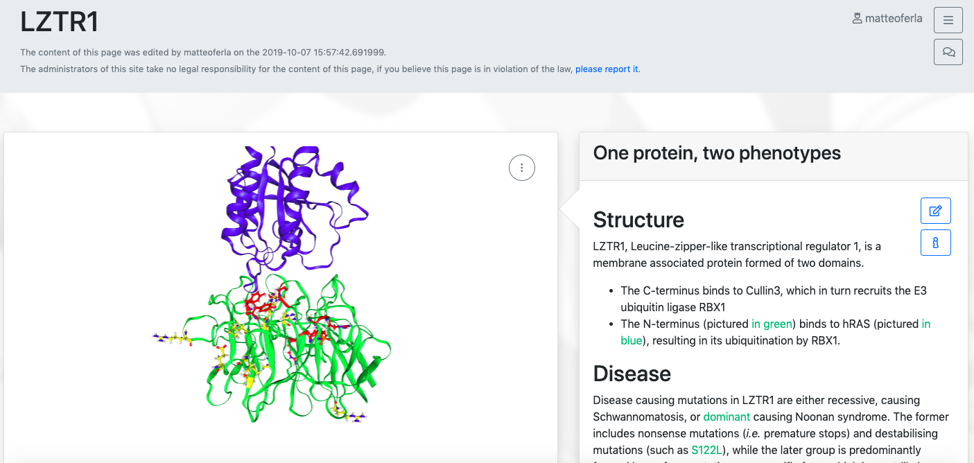
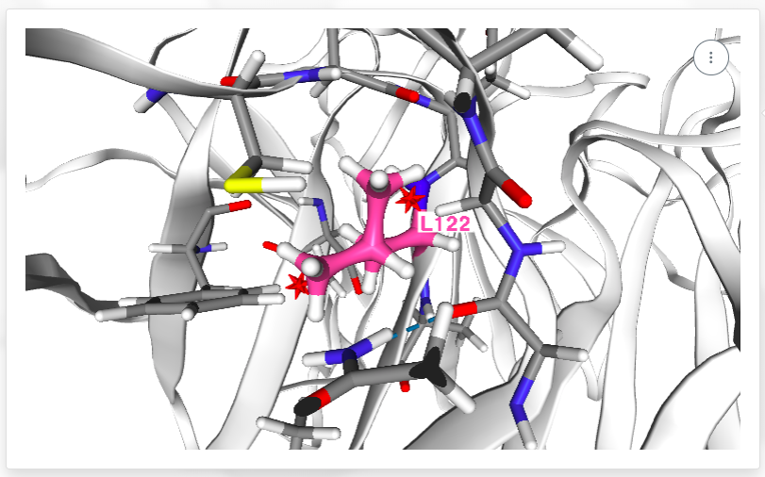

Interactive: protein controlling links
Changes

Slide 13
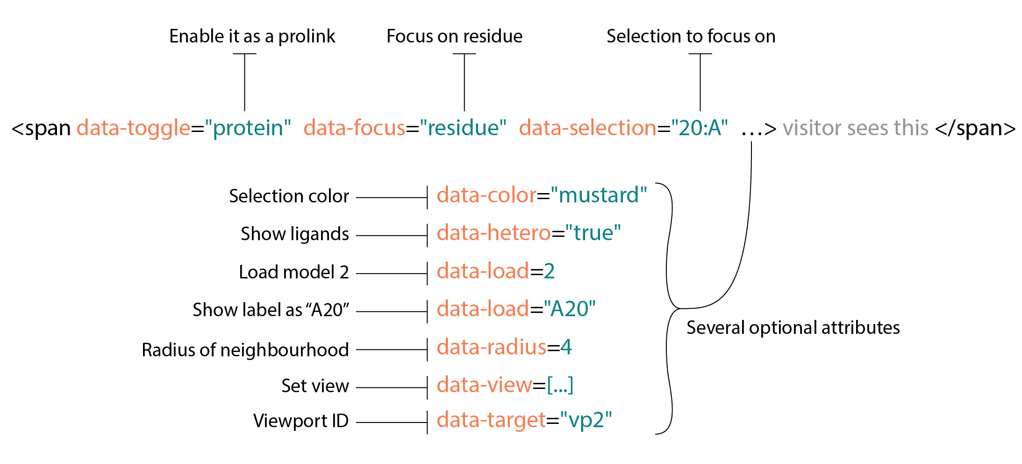
Anatomy of a “prolinks”

Slide 14
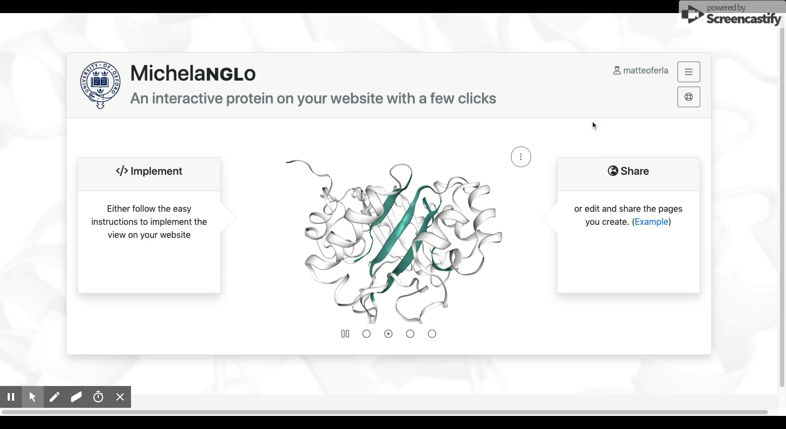
Demonstration

Slide 15
Acknowledgements
Wellcome
SGC
Jenny Tailor
Dimitrios Vavoulis
Alistair Pagnamenta
Carme Camps
Edoardo Giacopuzzi
Pamela Kaisaki
DPhil students
Brian Marsden
Leo Koukouflis
David Damerell
Rebecca Keyser
DPhil students
PDB
Alex Rose

